Slide 1
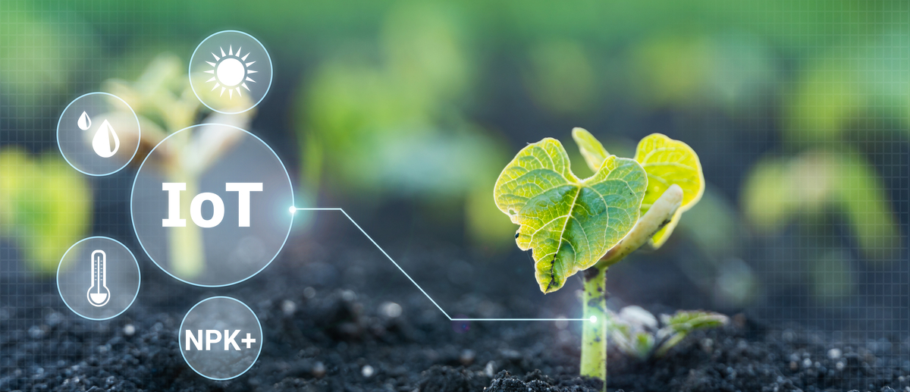
CROP MONITORING SMART AGRICULTURE
Prepared By: Shanaaz Ahamed

Slide 2
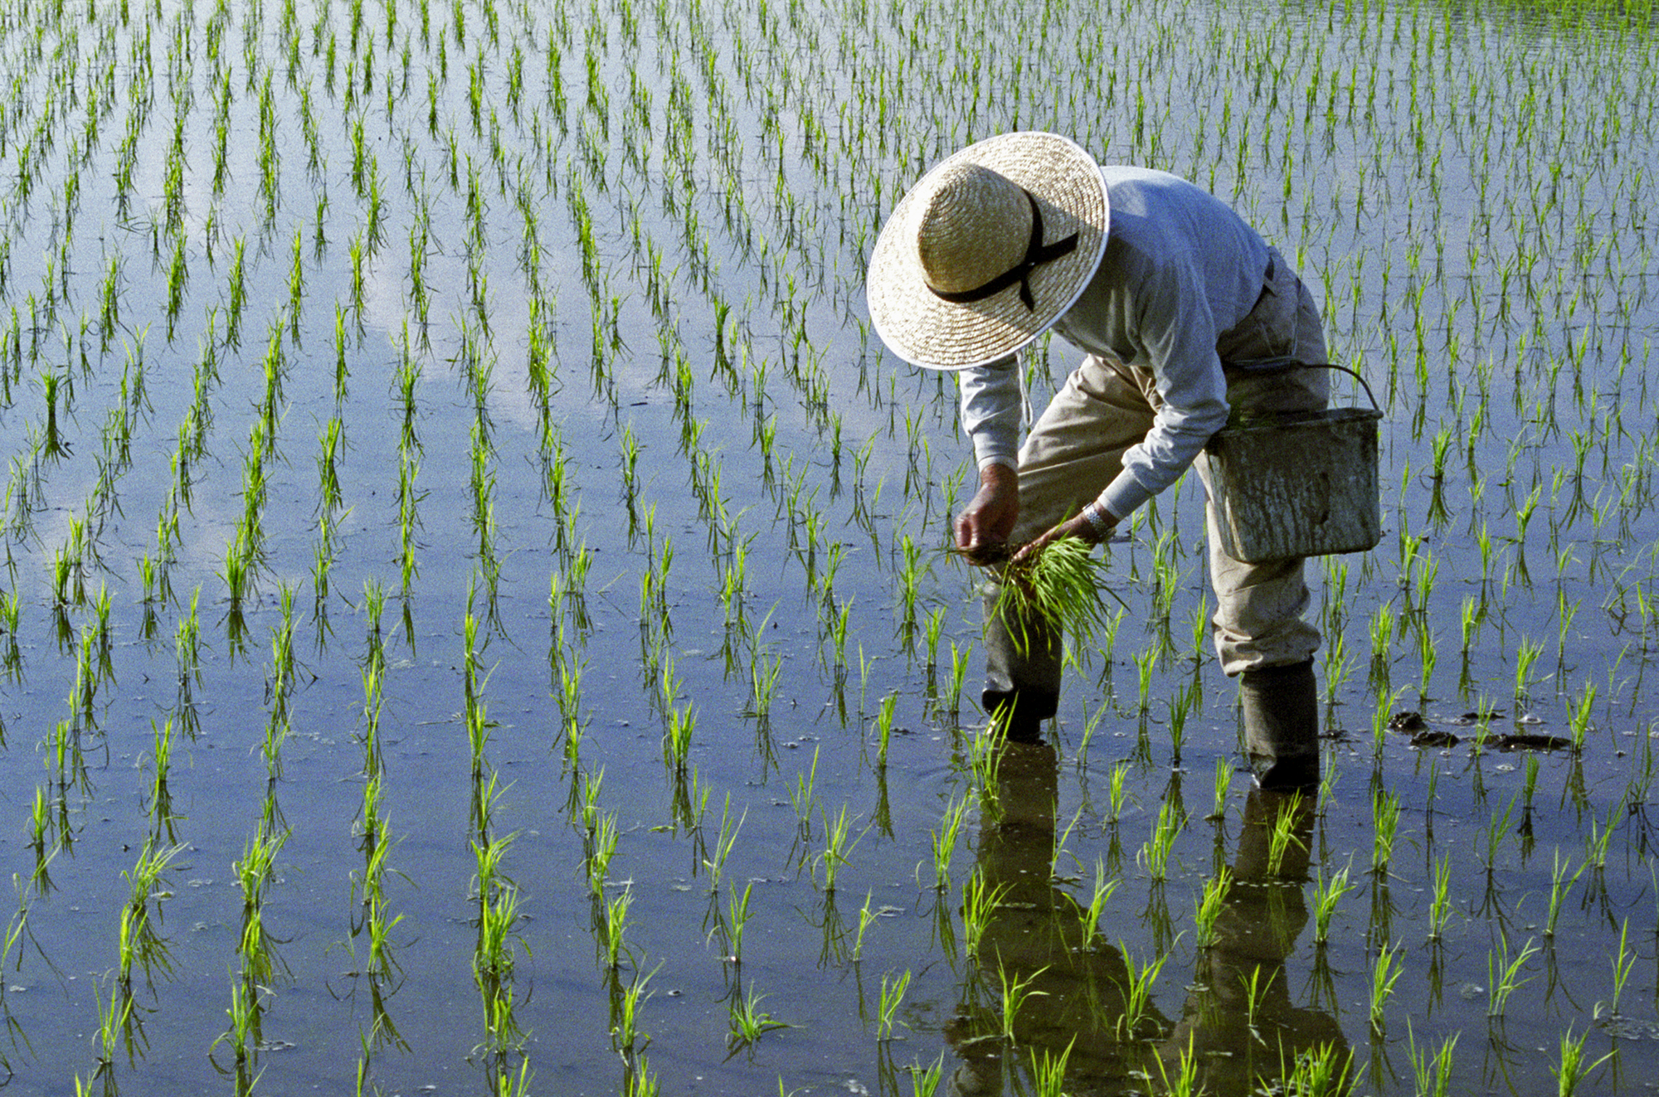
Introduction
Most of the farmers use unorganized knowledge, experience, and guess to apply fertilizers and water to agricultural fields.
Causes excessive resource usage.

Slide 3
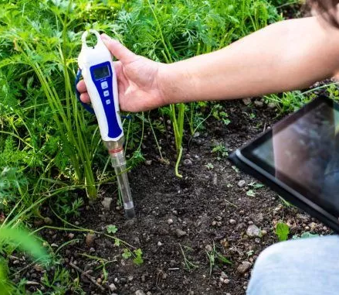
What will we measure
Things to measure regularly to get to know required water and nutrition level
Temperature
Humidity
Soil Moisture
Electric conductivity of soil
Rainfall
NPK
PH

Slide 4
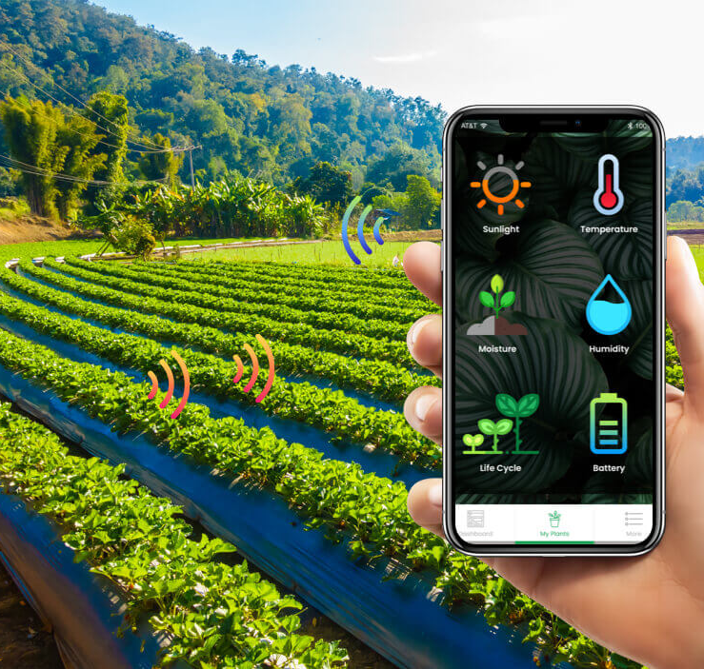
Visualization
Android app to visualize sensor data and control the device
Store in an embedded database on Android app
Fetch to a cloud database

Slide 5
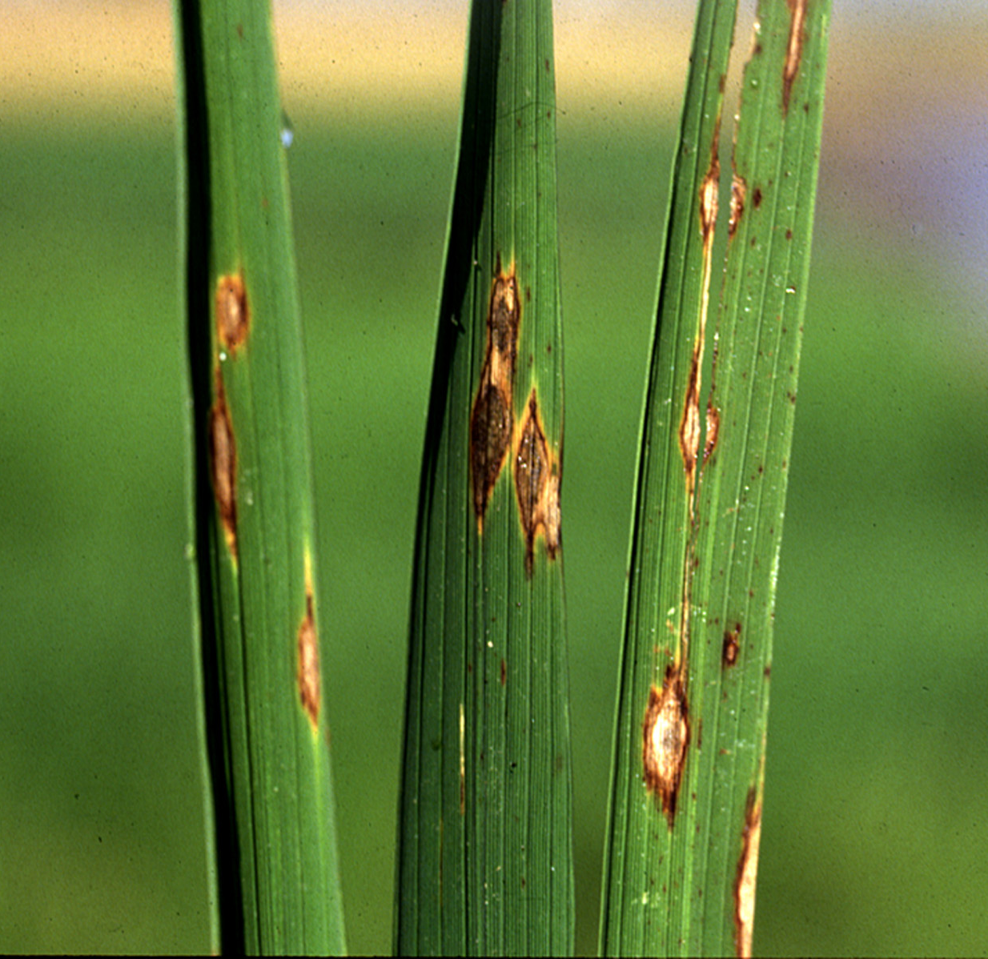
Plant Leaf Disease Detection
An image processing method to find the name of the disease.
Take the photo of the effected place by the connected phone and send to device to process

Slide 6
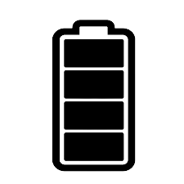
Features
Portable
Easy to carry and compact
Can be rechargeable
Can be easy to add more features in future
Sensors
Rechargeable
battery
Device

Slide 7
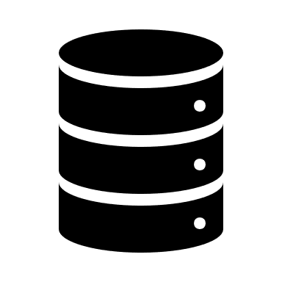
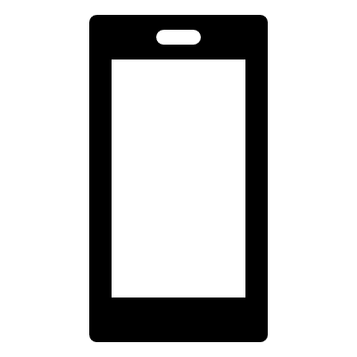
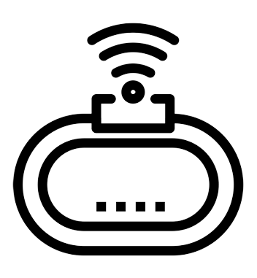




Connection Diagram
Embedded Database
{ }
Portable IoT Device
Cloud Database
Android App

Slide 8
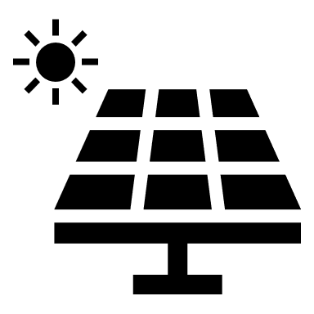
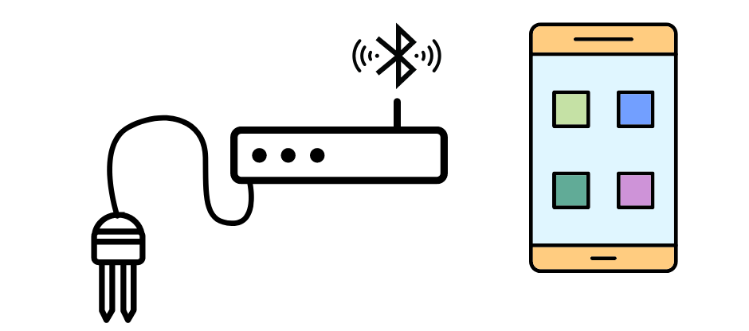

Prototype of the device
A solar panel
Android App
Device with a rechargeable power bank
Soil sensors

Slide 9
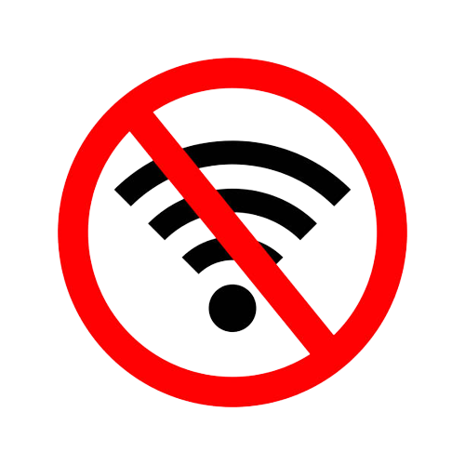
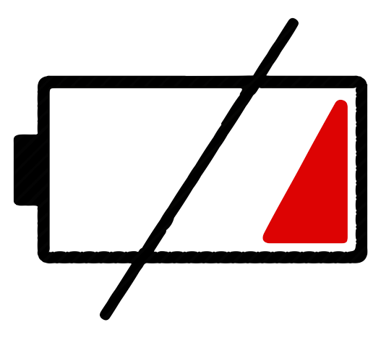
Sub Problems
Internet Connection need to be strong.
A power backup for the Device
Accuracy of the sensors
For the rainfall, we fetch data from an API which may not be accurate.

Slide 10
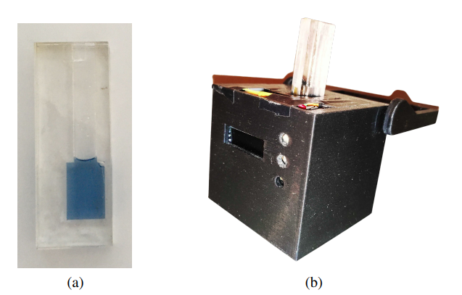
Research
IoT-based Soil Nutrient Analyser using Gaussian Process Regression
Using a wireless connection, a portable IoT device and a mobile app with machine learning capabilities enable quick estimation of soil nutrient concentrations.
device that measures the soil nutrient concentrations
Senevirathne, T. Ambegoda, R. Wijesena and I. Perera, "IoT-based Soil Nutrient Analyser using Gaussian Process Regression, " 2022 2nd International Conference on Advanced Research in Computing (ICARC), 2022, pp. 7-12, doi: 10.1109/ICARC54489.2022.9754105

Slide 11
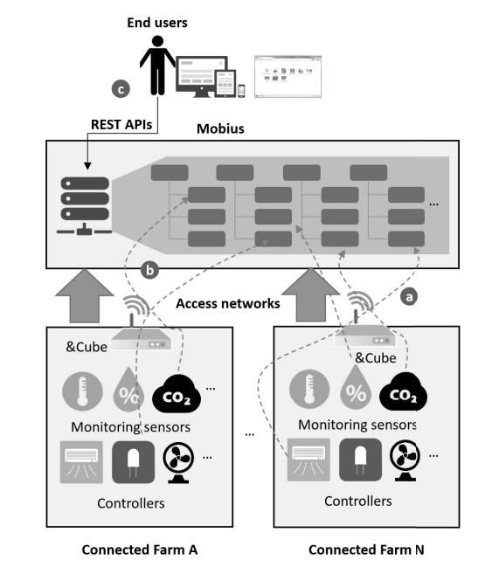
Researches
Design and implementation of a connected farm for smart farming system
A connected farm based on IoT systems to provide Internet connectivity for the sensors and controllers which is remotely monitored and controlled by a smartphone application
M. Ryu, J. Yun, T. Miao, I. -Y. Ahn, S. -C. Choi and J. Kim, "Design and implementation of a connected farm for smart farming system," 2015 IEEE SENSORS, 2015, pp. 1-4, doi: 10.1109/ICSENS.2015.7370624.

Slide 12
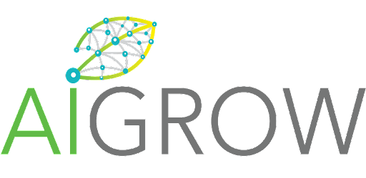
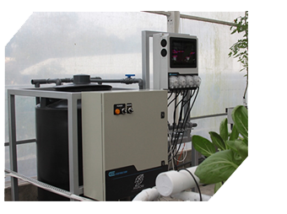
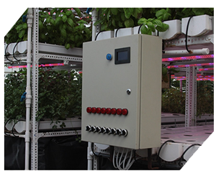
AiGrow
Provide services like Smart Sensor System, Water Recycle Reuse and Advanced Grow-Lighting etc. And also they produce E Fertigator, Relay Node, Sensor Nodes and Climate Control etc.
E Fertigator
Relay Node

Slide 13
Final Demonstration
Plan to do the demonstration in the lab
Take the variety of soil samples and do testing

Slide 14
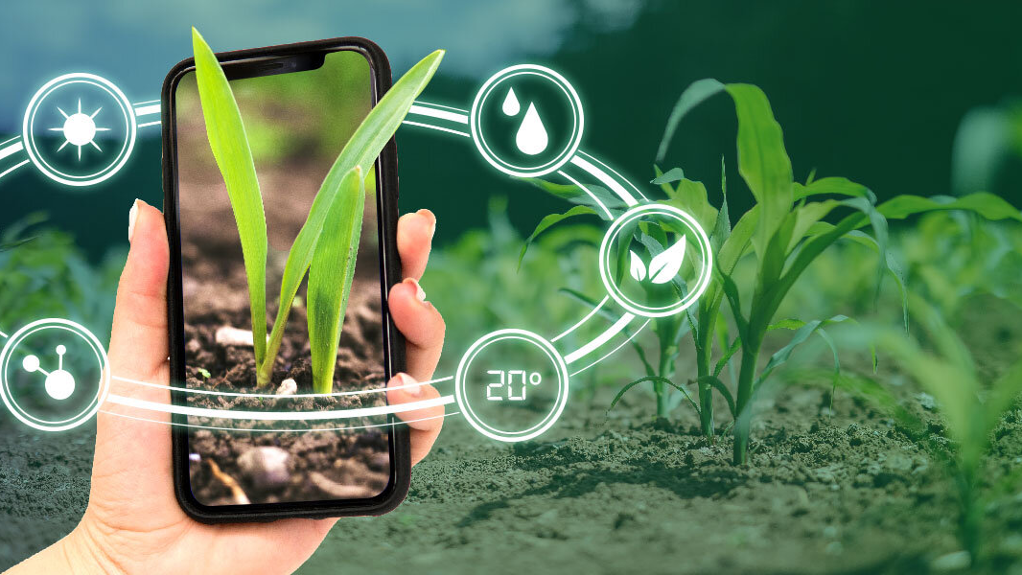
Thank You

